Slide 1
Mobile Sensors Workshop, Part 2: Digital
Pierce Nichols
15 February 2015

Slide 2
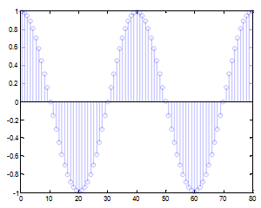
Analog to Digital Conversion
The ADC measure the signal at regular intervals.
Ideally, it measures it at discrete times.
Sample rate is the number of samples per second.
Resolution is the number of bins, expressed in bits (powers of two)

Slide 3
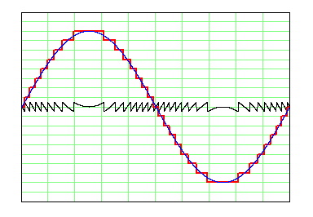
Quantization
ADC output can only assume a discrete number of values…
The difference between the real signal and your measured signal shows up as noise or error.
Minimized by using sufficiently high resolution ADC.

Slide 4
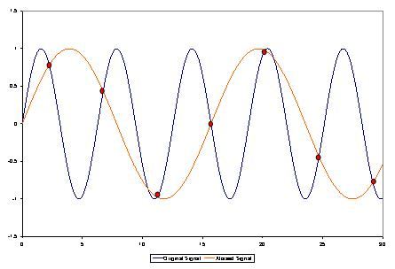
Aliasing
Since we’re only measuring at discrete times, it’s possible to get fooled.
Higher frequency signals can masquerade as lower frequency signals.
No way to tell the difference post sampling.
Notes:
Break out the one_channel_scope code and the function generator to demonstrate this.

Slide 5
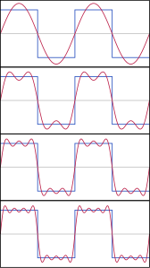
Fourier’s Theorem
All time varying signals can be expressed as a sum of sine waves of varying frequency, amplitude, and phase.
This means we can take a signal and express it in terms of the frequencies of the sine waves that make it up.
If this wasn’t true, the Internet wouldn’t work.

Slide 6
Nyquist-Shannon Sampling Theorem
If a signal x contains no frequencies higher than B Hz, it is completely determined by giving its value at a series of points spaced 1/(2B) seconds apart.
In order to accurately sample a signal, we need to exclude signals with a frequency greater than half of the sampling frequency.
Some signals we can trust don’t exceed half of the sampling frequency…
But mostly we filter higher frequencies out.

Slide 7
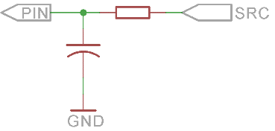
The RC (resistor-capacitor) filter
A resistor-capacitor is the simplest sort of filter.
The equivalent resistance of the capacitor is frequency dependent
This functions as a frequency-dependent voltage divider.
This is a low-pass filter; swapping the components makes a high-pass filter.

Slide 8
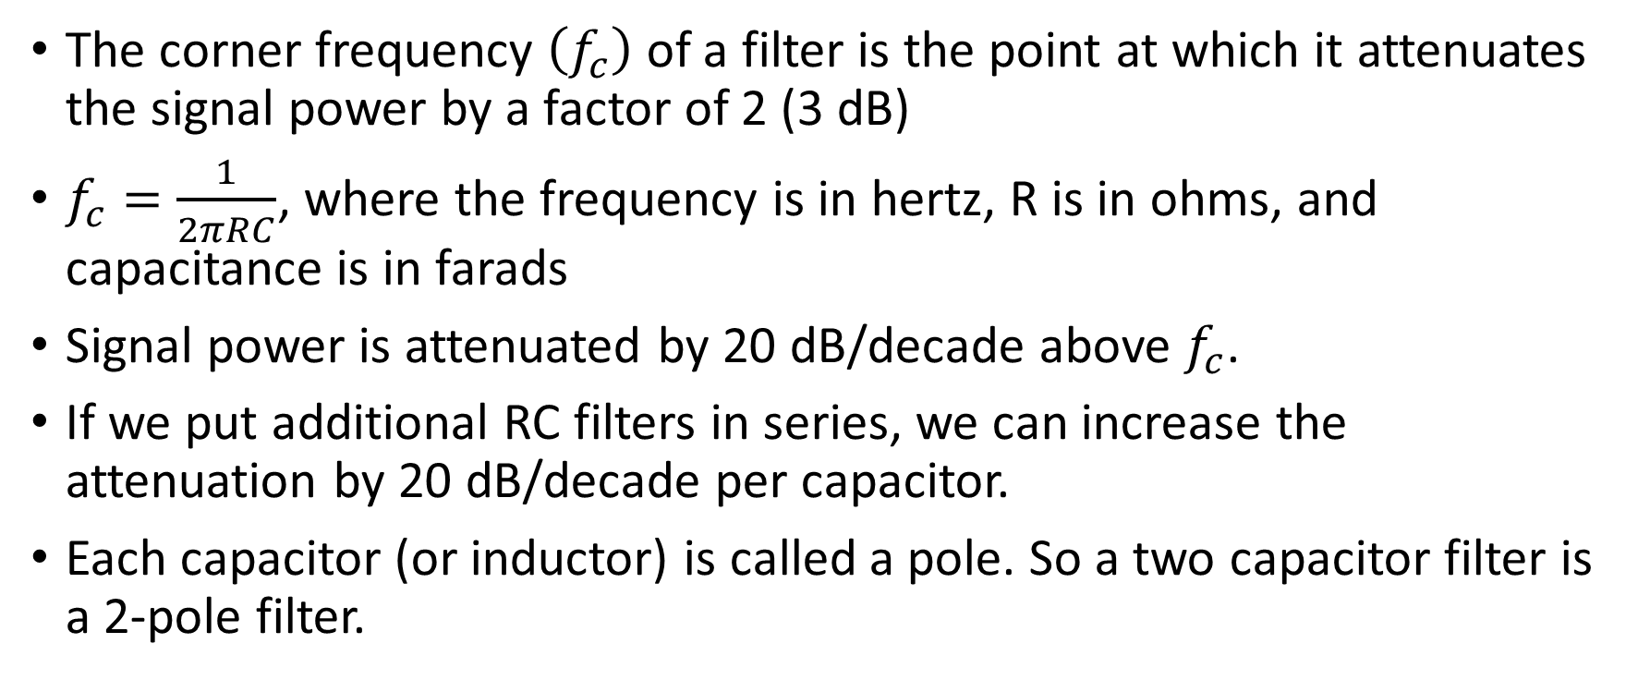
Sizing the RC filter
The corner frequency $\left(f_{c}\right)$ of a filter is the point at which it attenuates the signal power by a factor of 2 (3 dB)
$f_{c}=\frac{1}{2πRC}$, where the frequency is in hertz, R is in ohms, and capacitance is in farads
Signal power is attenuated by 20 dB/decade above $f_{c}$.
If we put additional RC filters in series, we can increase the attenuation by 20 dB/decade per capacitor.
Each capacitor (or inductor) is called a pole. So a two capacitor filter is a 2-pole filter.

Slide 9

Example calculation
R = 100 kΩ
C = 100 nF
$f_{c}=\frac{1}{2π\left(100∗{10}^{3}\right)\left(100∗{10}^{−9}\right)}=15.9 Hz$

Slide 10
A quick note on decibels (dB)
The decibel is a logarithmic unit for expressing ratios
10 dB is one order of magnitude (x10) when measuring power
20 dB is one order of magnitude when measuring voltage or amplitude, since power is usually proportional to the square of amplitude
Decibels used to measure things like sound power and output power are based on some reference level
Sound in air, 1 dB = 20 micropascals
Sound in water, 1 dB = 1 micropascal
RF output, 1 dB = 1 mW

Slide 11
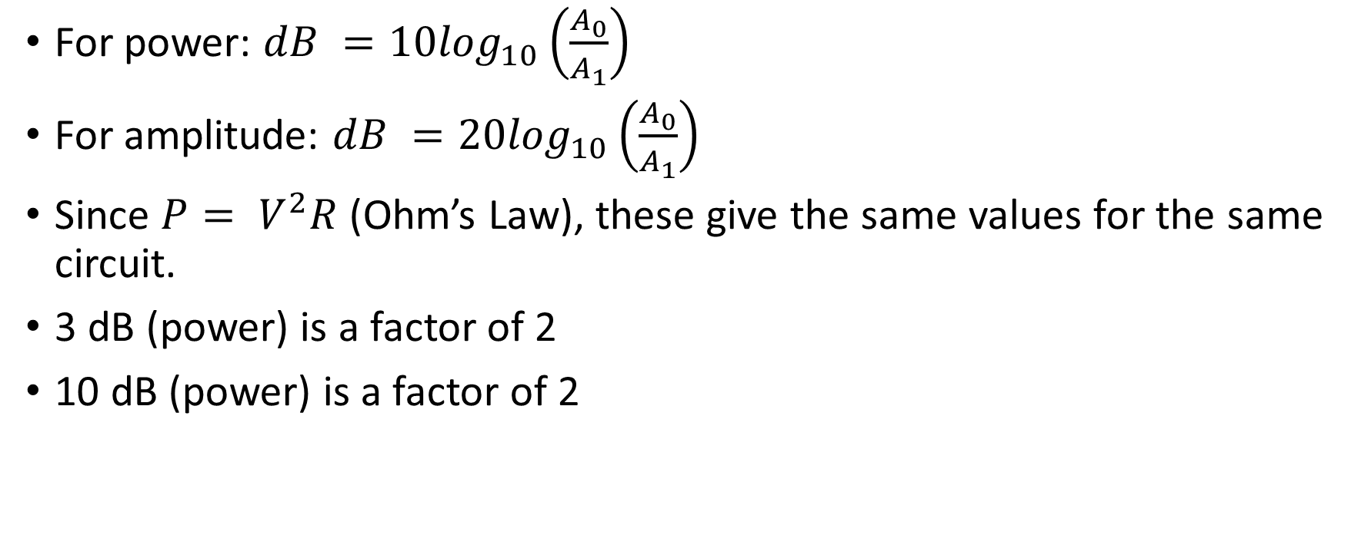
Calculating dB
For power: $dB =10\log_{10}\left(\frac{A_{0}}{A_{1}}\right)$
For amplitude: $dB =20\log_{10}\left(\frac{A_{0}}{A_{1}}\right)$
Since $P= V^{2}R$ (Ohm’s Law), these give the same values for the same circuit.
3 dB (power) is a factor of 2
10 dB (power) is a factor of 2

Slide 12
More advanced filters…
It is possible to make a multi-pole filter with a passband gain of 1 (or higher) by adding op-amps to the mix.
A Sallen-Key filter gives two poles per op-amp
A Biquad filter can, with proper passive selection, replicate any continuous filter function.
Typical modern practice is to minimally filter the signal, oversample enormously, and then do all remaining filtering digitally.

Slide 13
Ten minute break…

Slide 14
Digital sensors
Digital sensors are sensors that have the sensor, signal conditioning, ADC, and perhaps some post-processing integrated into a single device.
Digital sensors communicate with the rest of your system over some sort of digital link rather than by voltage or current.
External ADCs are also available and communicate like digital sensors.

Slide 15
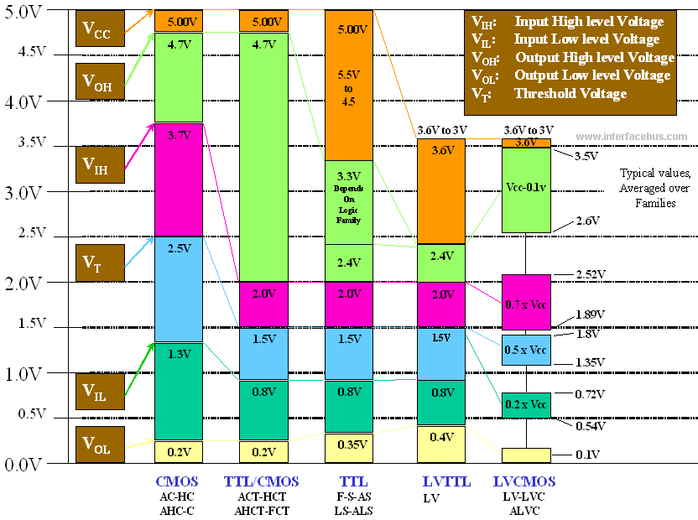
Digital logic
Digital logic consists of ones and zeros, corresponding to high and low voltage levels.
Arduino is a bit more robust than this.

Slide 16
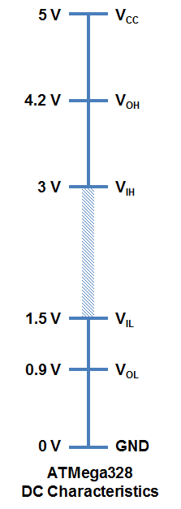
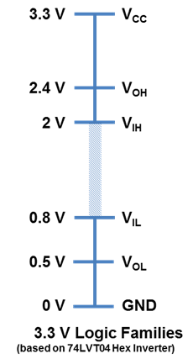
Arduino digital levels
Arduino levels are a bit different than standard TTL or CMOS.
Interoperable with 3.3V CMOS as long as absolute maximums not exceeded.

Slide 17
Digital busses for sensors
TTL Serial – Simple, implemented in hardware on nearly every µC. One wire for each direction plus ground.
Serial Peripheral Interface (SPI) – Widely implemented in hardware, speeds to ten of megabits/sec, good noise resistance. Requires three wires, ground, and one select line per device on multi-drop busses. Good noise immunity, fast.
Parallel – One wire per bit plus ground and a clock/latch line. Extraordinarily fast.
Inter-IC (I²C) – Two wires (SDA & SCL) plus ground. 7-bit addresses, so up to 112 devices on a single bus. Not very fast and questionable noise immunity, but very common.

Slide 18
I²C Properties
Leader-follower bus architecture. One device (the Arduino in our case) is the leader, and all other devices follow.
SDA (data) and SCL (clock) lines are pulled up to Vcc by pull-up resistors.
Active state (the one) of each line is ground.
Typical clock frequency is 100 kHz
High speed mode (supported by Atmega328P but not Arduino) is 400 kHz.
Leader mode supported by Arduino Wire library.

Slide 19
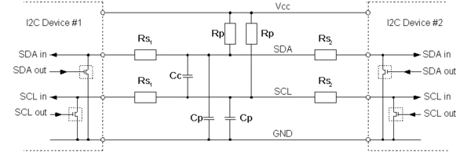
I²C Connections

Slide 20
I²C component selection
Minimize series resistances (R_{s})
Pull-up resistors 2kΩ – 10kΩ. Smaller resistors for longer wires/faster speeds.
Minimize parasitic capacitance between wires (C_{c})
Parasitic capacitance between wires and ground (C_{p}) must be less than 400 pF
Longer lines = higher parasitic capacitance!

Slide 21
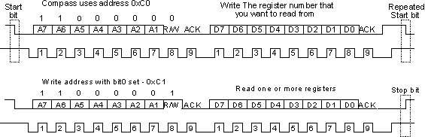
I²C communications

Slide 22
Ten minute break…

Slide 23
9-DoF IMU (
Nine degrees of freedom inertial measurement unit
3 axis accelerometer
3 axis rate gyroscope
3 axis magnetometer (compass)
All sensors communicate I²C
Cheap sensors enabled by cell phone requirements

Slide 24
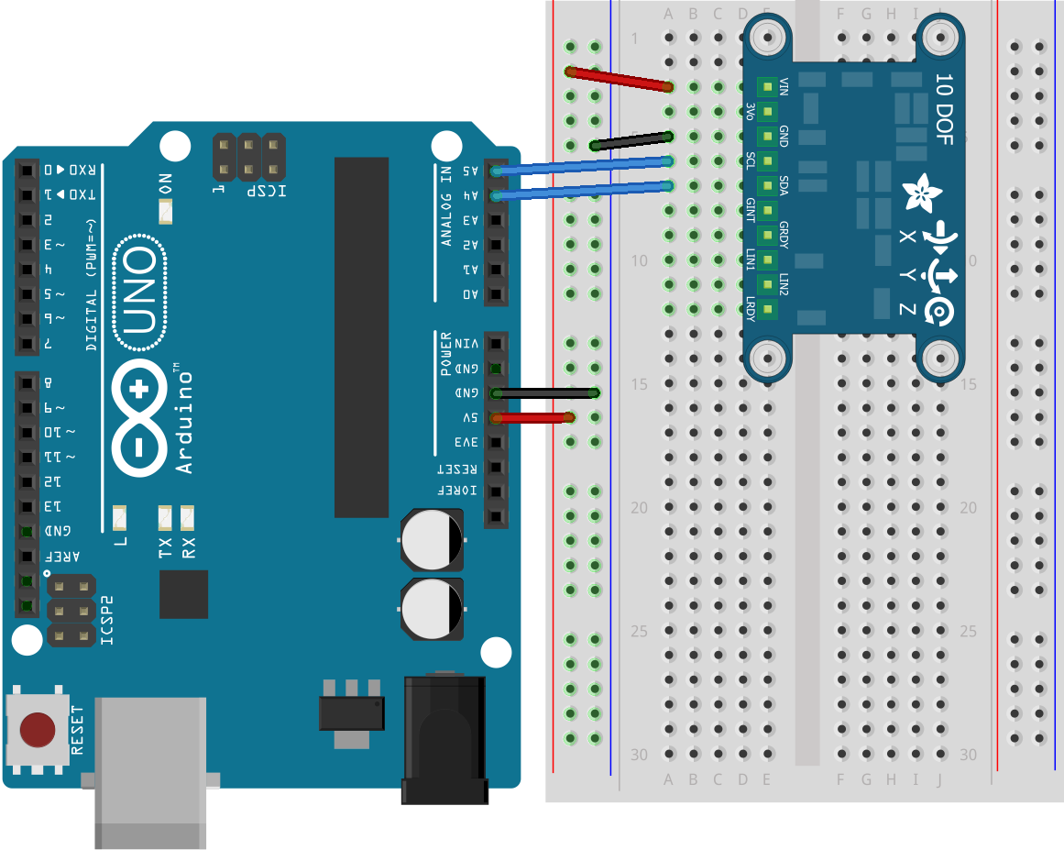
Wiring up the IMU

Slide 25
Libraries required
Move the following directories from the Arduino/libraries directory in the class files to your Arduino/libraries directory.
Adafruit_Sensor
Adafruit_LSM9DSO
Adafruit_AHRS

Slide 26
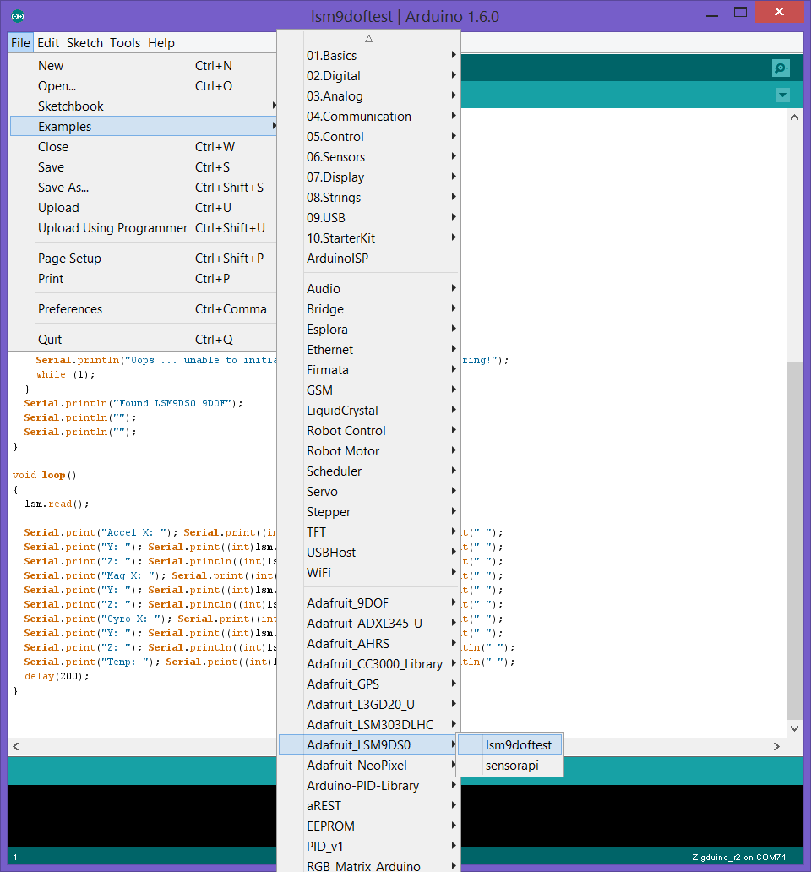
Opening the ‘tester’ example sketch

Slide 27
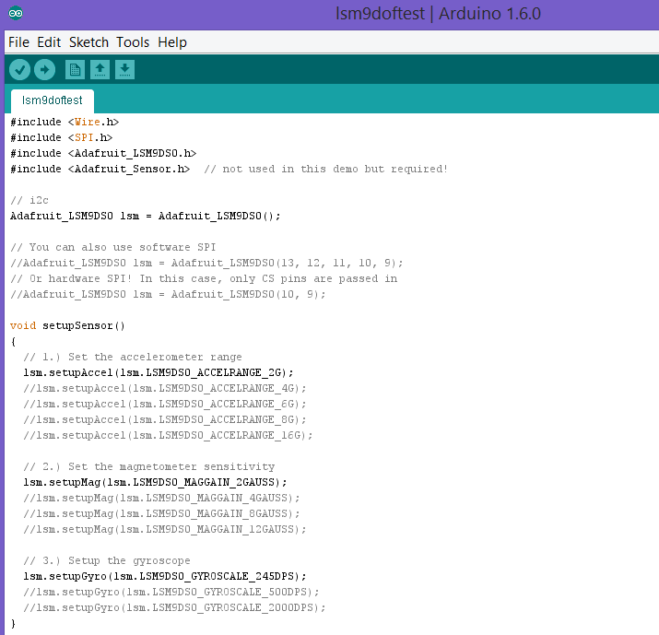
Start of the code…

Slide 28
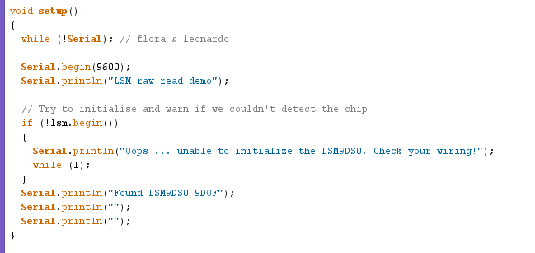
Setup…

Slide 29
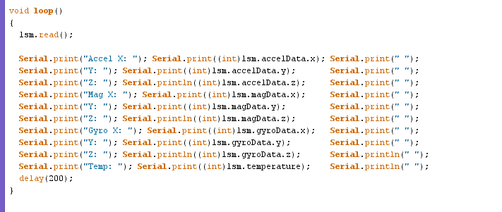
Grabbing & printing the data

Slide 30
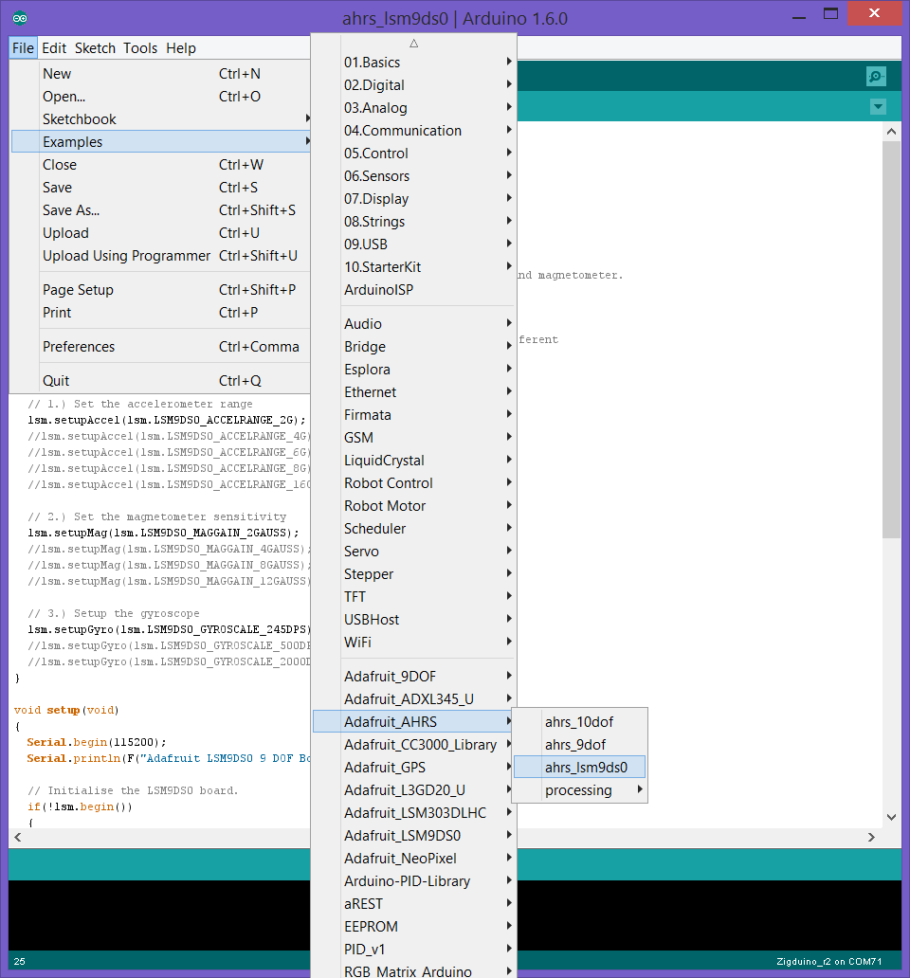
Open the ahrs_lsm9ds0 example

Slide 31
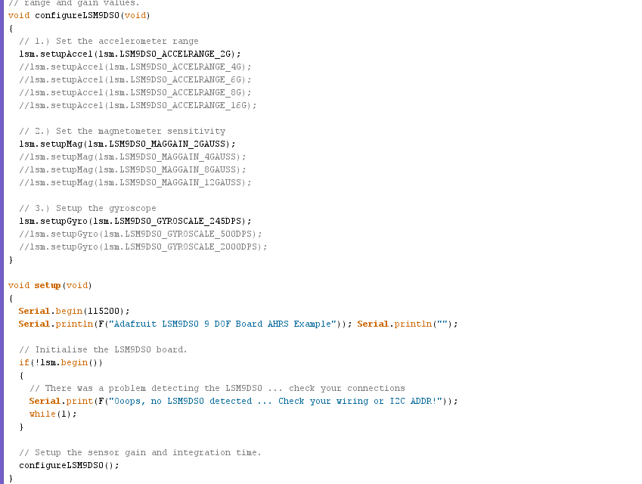
AHRS (attitude & heading reference system) startup code

Slide 32
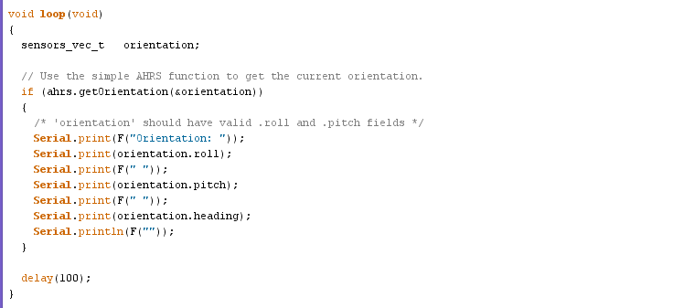
Grabbing the data…

Slide 33
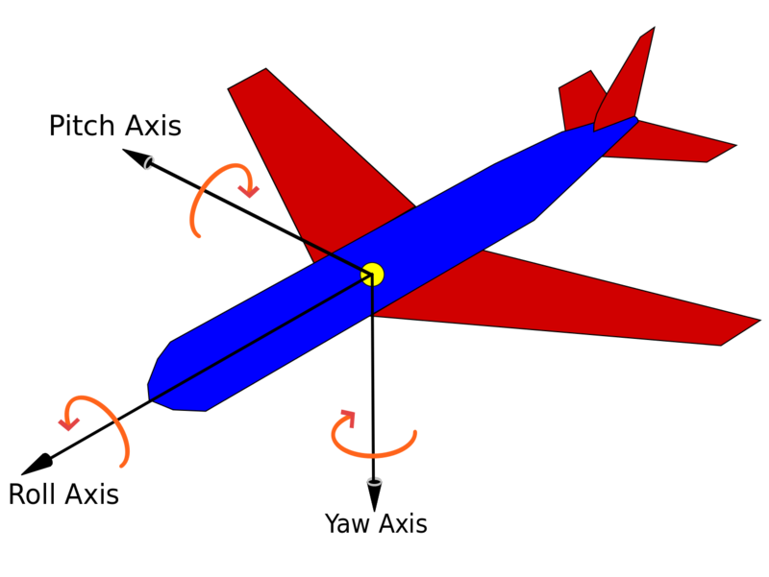
Euler angles
Angles around the axes
Roll is around X axis, pitch is around Y axis, and yaw is around Z axis
Order is important!
Z axis points down so positive yaw angle has the same sense as a compass.

Slide 34
Limits of the Adafruit AHRS code
Doesn’t incorporate gyro data
Assumes that the acceleration vector always points down
Doesn’t fix the data rate as a constant
Magnetometer & accelerometer need calibration for best performance.

Slide 35
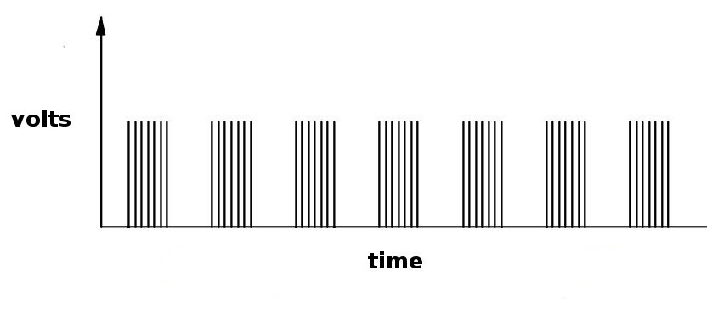
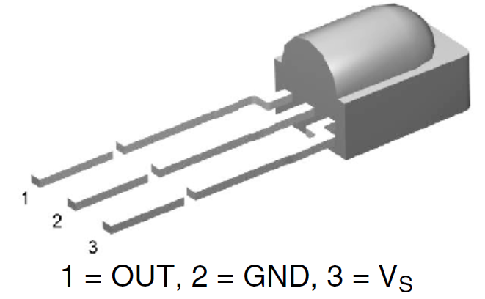
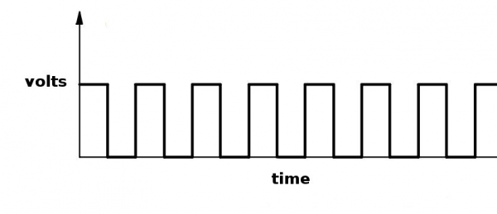
One last device (not really a sensor)
Each kit also contains a near IR receiver
Demodulates remote control signals (38 kHz modulation)
Active low output

Slide 36
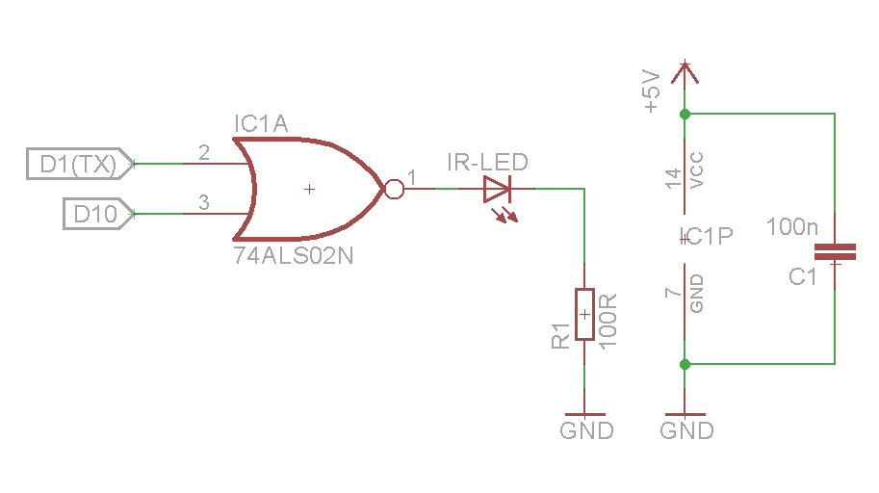
Serial IR transmitter hookup
Connect transmitter as shown.
Connect output of IR receiver to D0 (RX)
D10 is used as an output for the Tone library.
The NOR output is high only when both inputs are low… which produces a matching signal to D1 on the IR receiver output.

Slide 37
Serial IR demo code
Load serialIRtransmitter.ino on one Arduino and serialIRreceiver.ino on another. Start serial monitor on the receiver side at 2400 baud
Point the LED at the receiver. Note that the beamwidth is very narrow, so this may take a few tries.
Watch the serial monitor for signs of contact.
Try moving the two sides apart.

Slide 38
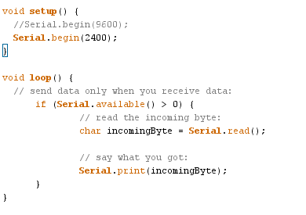
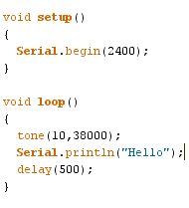
Serial IR code

Slide 39
Source for parts & kits
Local
Online
Ada’s Technical Books
Vetco
Alphatronics
Fry’s Electronics
Metrix Create Space
Digikey (www.digikey.com)
Mouser (www.mouser.com)
Sparkfun (www.sparkfun.com)
Adafruit Industries (www.adafruit.com)
Solarbotics (www.solarbotics.com)
Makershed (www.makershed.com)

Slide 40
Books
Electronics
Sensors
Make: Electronics (Platt)
Engineer’s Mini Notebooks Vol 1 – 4 (Mims)
The Art of Electronics 2nd Ed (Horowitz & Hill)
Circuit Design: know it all (Ashby et al)
Arduino Cookbook (Margolis)
Handbook of Modern Sensors (Fraden)
Data Analysis
The Statistical Analysis of Experimental Data (Mandel)
AHRS & Euler Angles
Physics for Game Developers (Bourg)

Slide 41
Online learning resources
Sparkfun (learn.sparkfun.com)
Adafruit (learn.adafruit.com)
Arduino Playground (playground.arduino.cc)
Arduino Forum (forum.arduino.cc)
Arduino Reference (arduino.cc/en/Reference/HomePage)
Wikipedia

